Slide 1
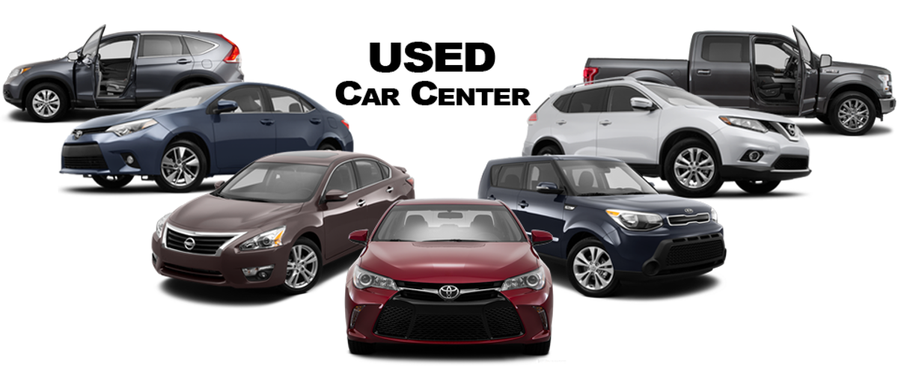
USED CAR SALES -EDA

Slide 2

Hello!
I am Pankaj Raut
I am here because I love to give presentations on EDA.
You can connect me at pankaj249125@gmail.com

Slide 3
Problem Statement
Introduction to Used Car sales Dataset
Exploring the Dataset (EDA)
Actionable Insights
Observation and Conclusion
1
2
Agenda
3
4
5

Slide 4

Problem statement :
In the past few years, prices of new cars have skyrocketed, due to which most people are incapable of buying a new one.
Customers buying a new car always looks for assurity of their money to be worthy. But due to the increased price of new cars, used car sales are on a global increase.
There is a need to effectively determine on what factors to be consider while selecting used Cars and get more resale value if want to sell.

Slide 5
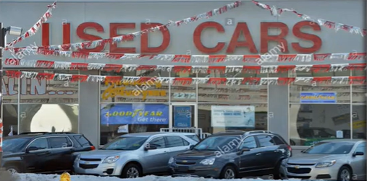
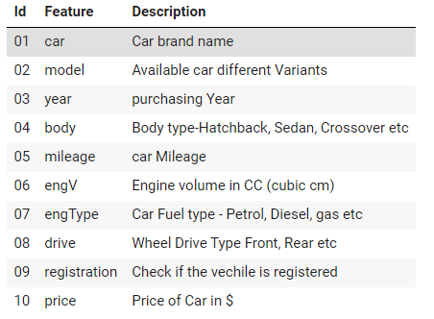
Introduction:
This dataset contains one of Used car company sale. Sales history from 1950 till 2016.
This dataset contains data for more than 9.5K cars sale.
Dataset contains 9576 rows and 10 variables for visual data analysis

Slide 6
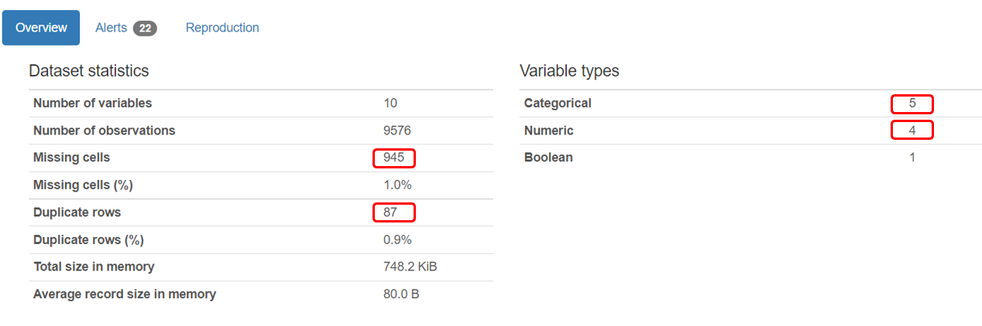
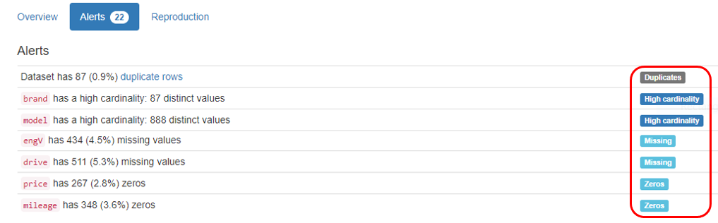
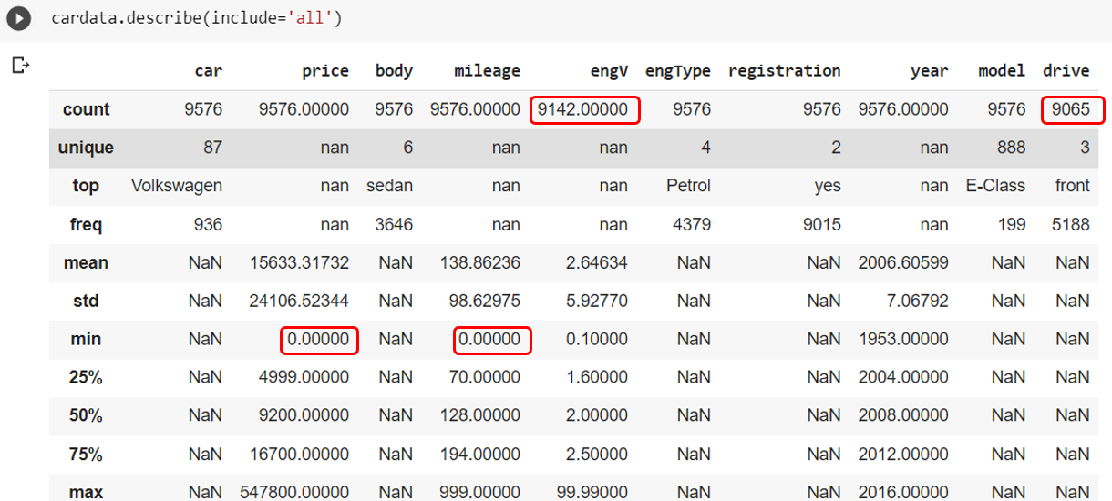
Data pre profiling
Action Points:
Drop 87 rows duplicate record
945 missing cells, 511 from drive and 434 from EngV. Replace drive missing cells by mode “front” Similarly Replace engV missing cells by median value 2.
Price has 267 cell with “0” values, Replace price “0” value cells by median 9200.
Similarly mileage has 348 cells with “0” values , Replace “0” value cell by median value 129

Slide 7
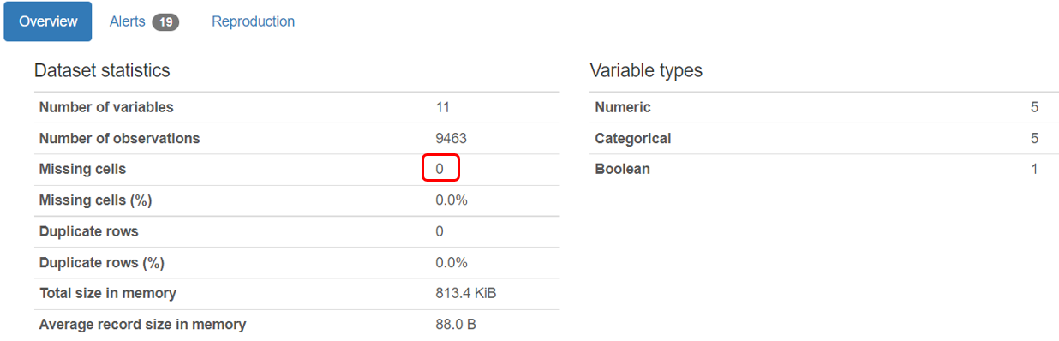
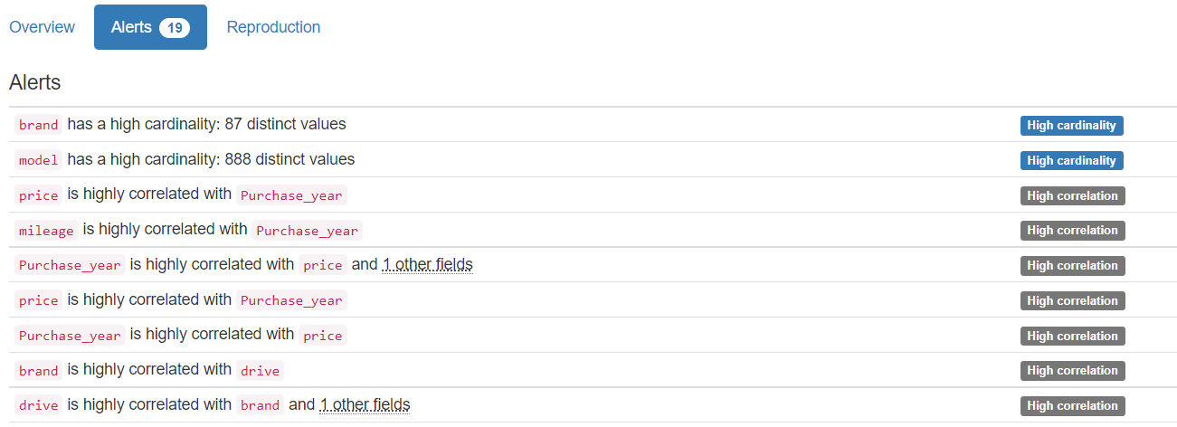
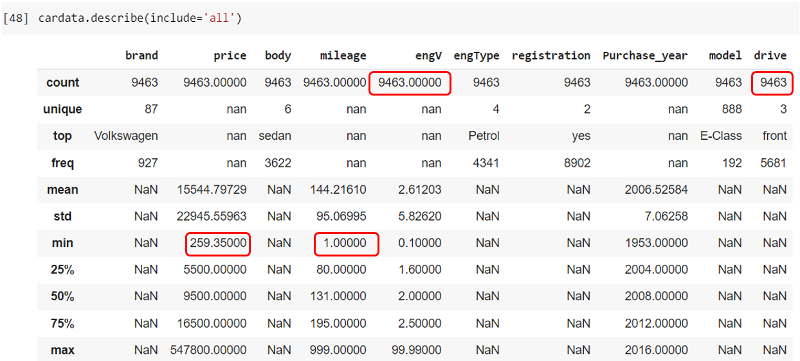
Data post profiling
No Missing Values after Post profiling and Data is ready for EDA

Slide 8
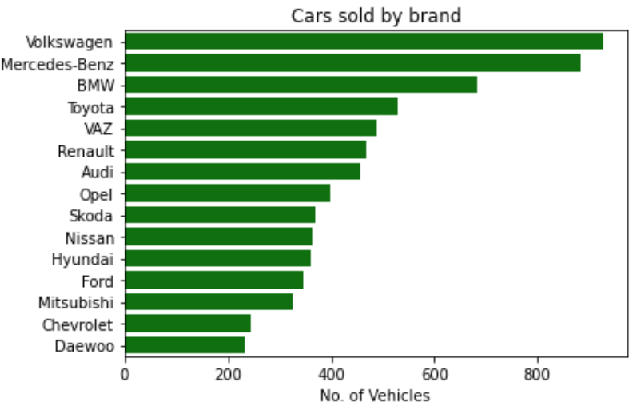
Data Exploration
Highest Number of Car Sold by Brand
By this chart we can say that the most cars sold by the company Volkswagen followed by Mercedes-Benz and BMW

Slide 9
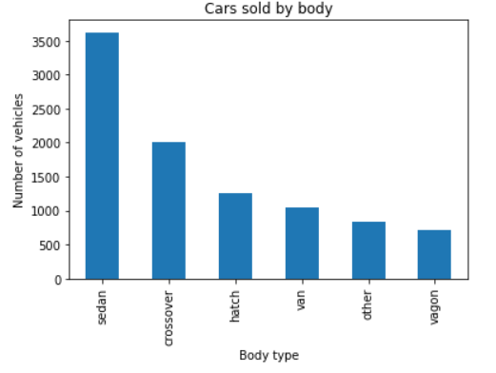
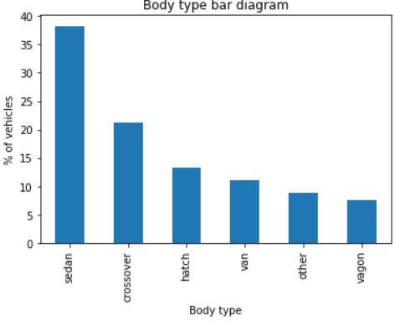
Data Exploration
Body Segment in which Car sold most and its Share
This chart says that "Sedan" body type cars are the most sold cars, 38% of total cars sold in Sedan body type, 21% in Crossover body type and 13% in Hatch body type. We can say this in other terms that the most preferred choice for people is Sedan, because it is the perfect and comfortable car for small size family within lower budget.

Slide 10
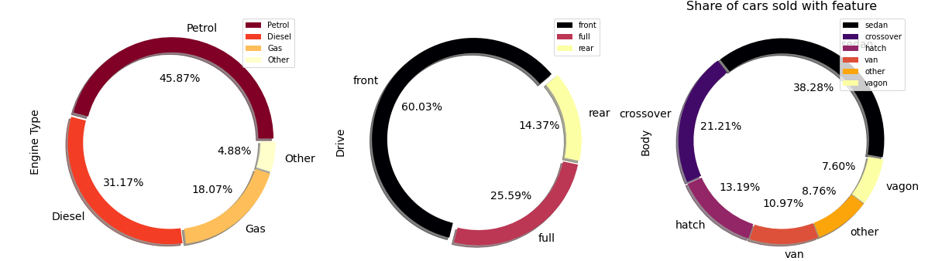
Data Exploration
Share of number of cars sold with feature
Petrol is more popular 45.87% followed by diesel 31.17% fuel type
front wheel drive more preferable 60.03% followed by full drive 25.59% in drive type
Sedan is most popular 38.2% followed by crossover 21.2 % in body type

Slide 11
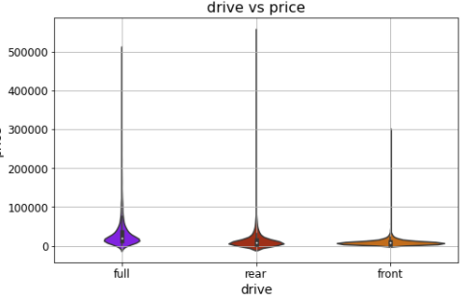
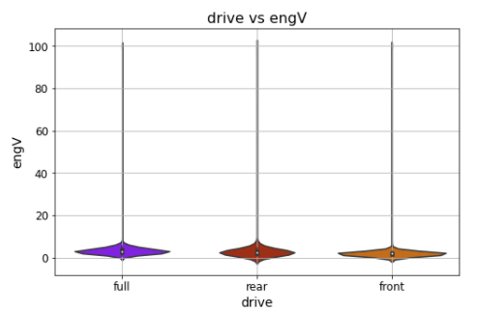
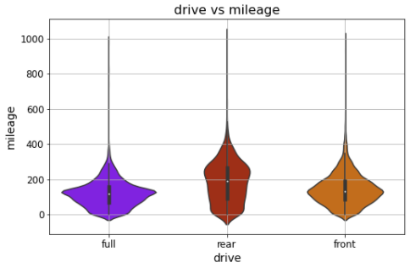
Data Exploration
Data distribution against drive
From Above Graph Car "Price" has outliers above Price 115000 USD. Similar "engV" has outlier above 10 cc engine. Similarly "mileage" has Outliers above 600 Mpg.
All data are highly right side Skew

Slide 12
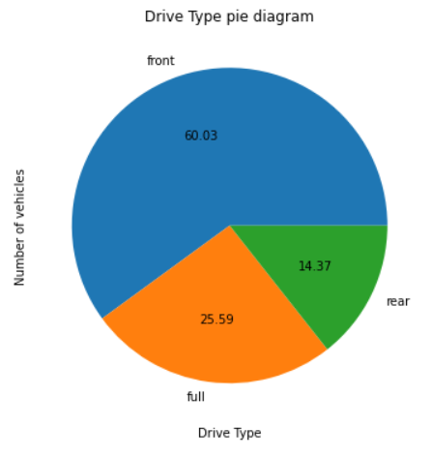
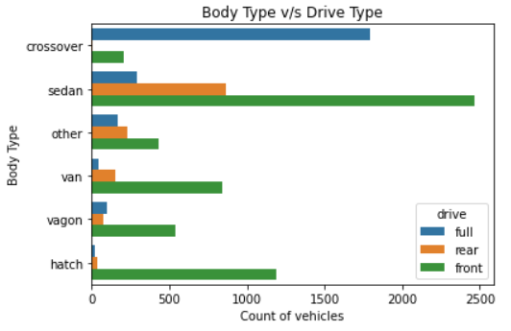
Data Exploration
drive segment of cars in which body type sold the most
We can say that the most sold cars in front drive type, in terms of percentage , approx. 60% of total cars sold in front drive type, 25% in full drive type and 14% in rear drive type.
"Front" wheel drive cars are the top most cars in all body type except in "Crossover" body type.
In "Crossover" body type "Full" wheel drive cars are leading

Slide 13
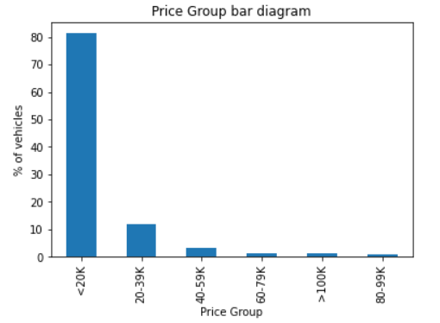
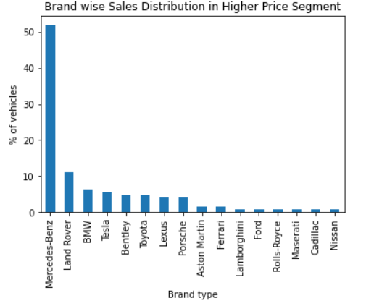
Data Exploration
price segment and brand wise cars sold the most
By this chart we can say that approx. 80% of cars sold in the price range of less than or equal to $ 20000
"Mercedes-Benz" is the leading brand in higher price segment cars

Slide 14
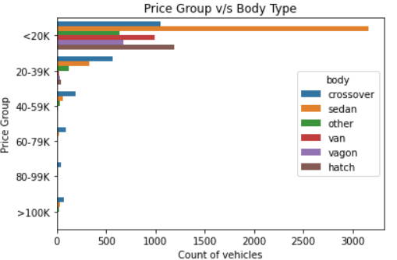
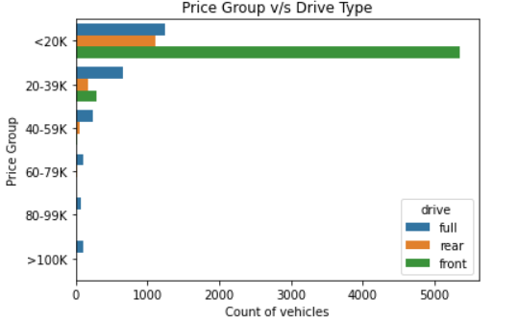
Data Exploration
How does price relate to body and drive type of car?
The most cars sold in price range of 200 to 19999 and majority of these are in Sedan body type.
The majority is Crossover body type in Cars sold at a price 20000 or above.
The most cars sold in price range of 200 to 19999 and majority of these are in Front drive type.
The majority is Full drive type in Cars sold at a price 20000 or above.

Slide 15
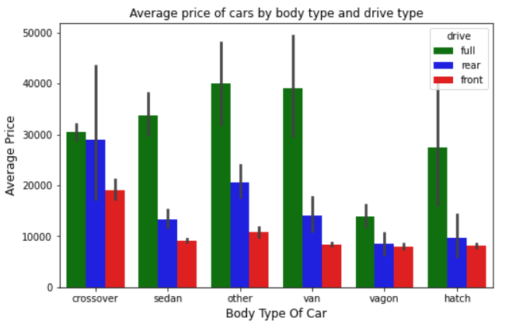
Data Exploration
Average price of vehicles by body type and drive type
By this chart we can say that all body types of cars have more average price for full drive type cars compare to other drive types.

Slide 16
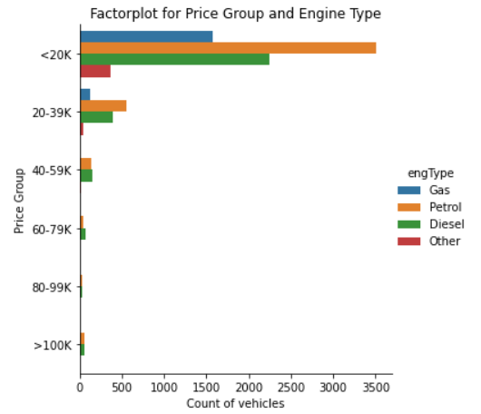
Data Exploration
Does the engType have any impact on price of the car?
The most cars sold in price range of 200 to 19999 and majority of these are in Petrol engine type.
The majority is Diesel engine type in Cars sold at a price 20000 or above

Slide 17
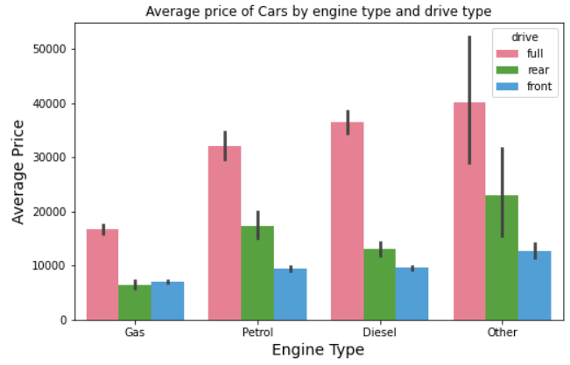
Data Exploration
How does price relate to engine type and drive type of the car?
By this chart we can say that the cars sold in all engine type have more average price for full drive type cars compare to other drive type cars.

Slide 18
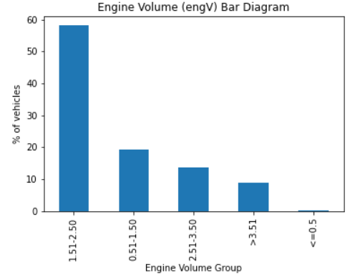
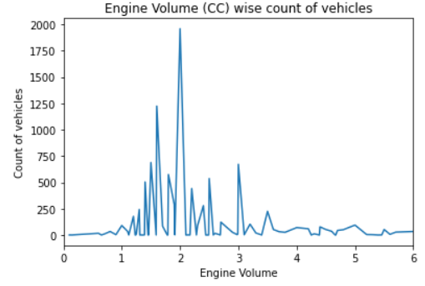
Data Exploration
Which engine volume (engV) cars sold the most ?
By this chart we can say that below are the top three categories of Engine Volume (engV) cars sold.
Ist Category : > 1.5 & <= 2.5 (In this category approx. 55% of cars are available)
IInd Category : > 0.5 & <= 1.5 (In this category approx. 19% of cars are available)
IIIrd Category : > 2.5 & <= 3.5 (In this category approx. 18% of cars are available)
Out of total cars sold, approx. 92% cars fall in range of engine volume more than 1.5 CC to 3.5 CC
By this chart we can say that most of the cars sold have 2.0 CC engine volume followed by 1.5 CC, there are very few cars sold with engine volume less than equal to 1.0 CC and greater than equal to 4.0 CC

Slide 19
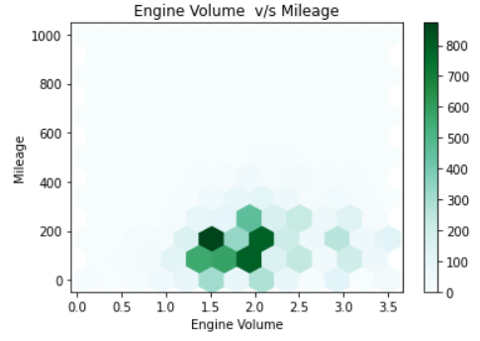
Data Exploration
How does engine volume (engV) relate to mileage of the car?
By this chart we can say that most of the cars sold with engine volume (engV) as 1.5 CC and mileage as approx. 200.

Slide 20
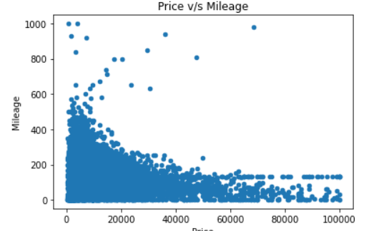
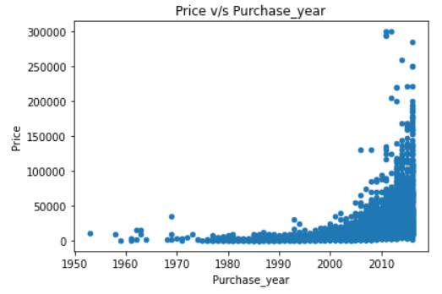
Data Exploration
How does price is related to mileage and Purchase year of the car?
By this chart we can say that price and mileage have strongly negative correlation in sold car dataset , i.e. lower price segment has higher mileage and higher price segment has lower mileage.
Majority of the cars with Purchase_year 2008 or later sold in price 50000 or lower.
All the cars with Purchase_year 2010 or later sold in price more than 50000.
All the cars with Purchase_year before 2010 sold in price 50000 or lower.

Slide 21
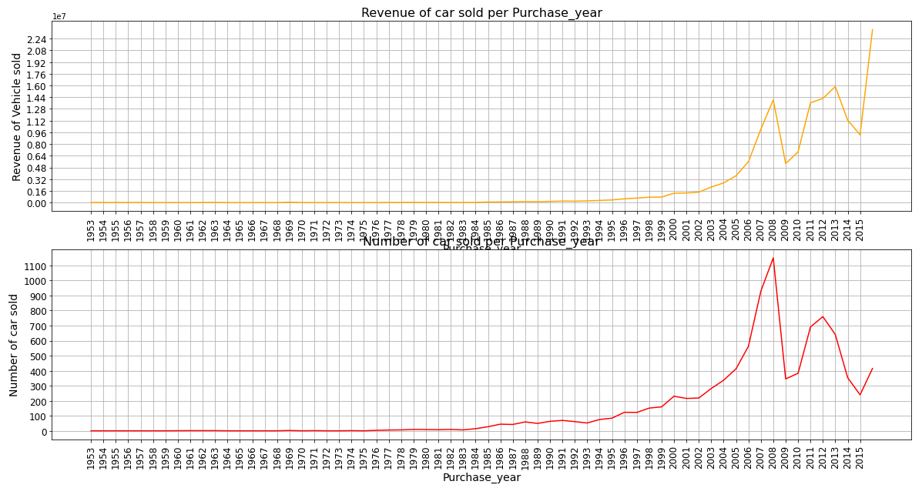
Data Exploration
Which Purchase_year of cars sold the most and How revenue relation with Purchase year?
By this chart we can say that Purchase_year 2008 and 2012 cars are sold the most. After Purchase_year 2008 and 2012 though car sales not increases but revenue increases . It mean customer is moving towards Expensive Cars.

Slide 22
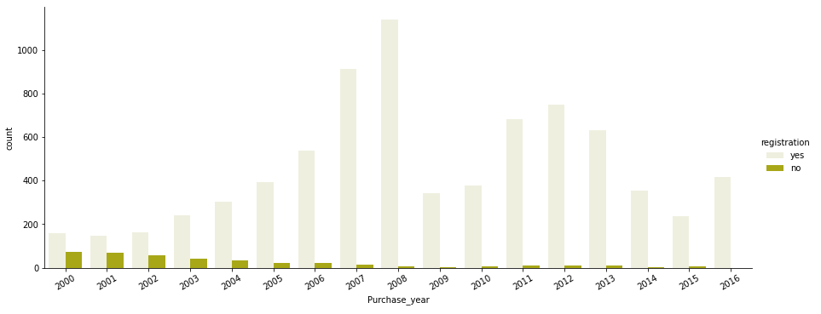
Data Exploration
How does Purchase_year relate to registration?
By this chart we can say that, After Purchase_year 2008 there is high probability that car is registered

Slide 23
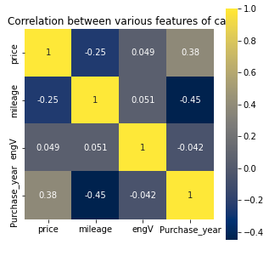
Data Exploration
Correlation between various features of car data.
By this heatmap we can say that:
price and Purchase_year variables have strong positive correlation, i.e. latest Purchase_year cars have high price and older Purchase_year cars have lower price.
price and engine volume (engV) have mild positive correlation.
engine volume (engV) and mileage also have some mild positive correlation, generally engine volume and mileage do not have positive correlation, but in our data most of the cars have engine volume in between 1.5 CC to 2.5 CC, due to that mileage and engine volume have mild positive correlation.
Purchase_year and mileage variables have strong negative correlation, i.e. latest Purchase_year cars have high mileage and older Purchase_year cars have low mileage.
price and mileage have negative correlation, i.e. lower price cars have higher mileage and higher price cars have lower mileage.
Purchase_year and engine volume (engV) also have some negative correlation.

Slide 24
Observation & Conclusion
In this dataset We have total 9463 observations after removing duplicate records.
We observe that out of total cars sold, majority of the cars sold by "Volkswagen", "Mercedes-Benz" and "BMW" brand.
"Sedan", "Crossover" and "Hatch" body types cars are the highest sold cars.
"Front" drive type segment cars are the highest sold cars, because most of the cars of this segment falls in lower price range.
"Front" wheel drive cars are the top most cars in all body type except in "Crossover" body type. In "Crossover" body type "Full" wheel drive cars are leading.
80% of total cars sold in the price range of 200 to 20000 with body type as "Sedan", drive type as "Front" and engine type as "Petrol", because the middle class families preferred low price cars with Sedan body and Petrol engine type.
"Mercedes-Benz" is the leading brand in higher price segment cars.
Majority of the higher price range cars sold with body type as "Crossover", drive type as "Full" and engine type as "Diesel".
All body segment of cars have more average price for "Full" drive type cars compare to other drive type cars.
All engine types of cars have more average price for "Full" drive type cars compare to other drive type cars.
Approx. 55% of total cars sold have engine volume in the range of 1.5 CC to 2.5 CC.
Most of the cars sold in 2.0 CC engine volume segment followed by 1.5 CC, there are very few cars sold below 1.0 CC and above 4.0 CC
We have also observed that lower price segment car has higher mileage and higher price segment car has lower mileage.
Majority of the cars with Purchase year 2008 or later were registered sold in price of 50000 or lower.
Purchase year 2008 and 2012 cars are the highest sold cars.
Price has positive correlation with engine volume and Purchase year and negatively correlation with mileage.

Slide 25
Actionable Insights :
In order to purchase car <= 20000 and to get Resale Value for the same, go for Front wheel drive car with Volkswagen/Mercedes/BMW, Sedan body and engV 2.0 CC and of Petrol type
For Higher Segment Purchase car >= 50000 and to get Resale Value for the same, go for Full drive car with Mercedes, Crossover body and engV above 4 CC and of Diesel type.
Majority of the cars with Purchase year 2008 or later were registered sold in price of 50000 or lower.
After Purchase_year 2008 and 2012 though car sales not increases but revenue increases . It mean customer is moving towards Expensive Cars.
It mean that there are few brand car which suffices customer requirement in the price range of 20000 to 40000
Customer mostly buy Full drive car if budget is more than 20000

Slide 26
Thanks!
Any questions?
You can find me at:
pankaj249125@gmail.com
user@mail.me

